Slide 1


Computer Architecture Spring 2020
Hamed Farbeh
farbeh@aut.ac.ir
Department of Computer Engineering
Amirkabir University of Technology

Slide 2
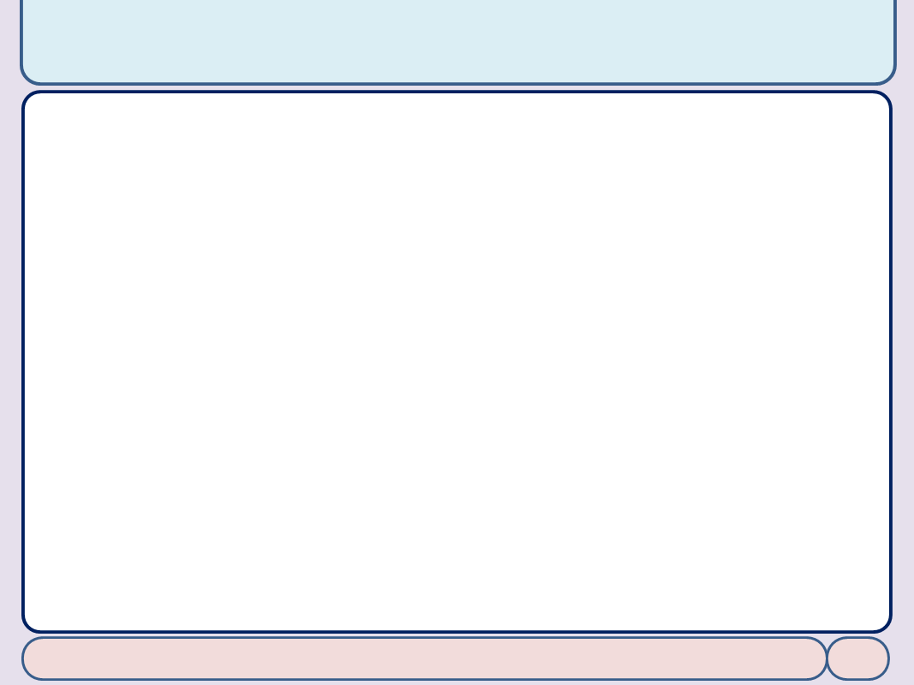

Copyright Notice
Lectures adopted from
Computer Organization and Design: The Hardware/Software Interface, 5th edition, David A. Patterson, John L. Hennessy, MK pub., 2014
Chapter 3: Arithmetic for Computers
Computer Architecture, Spring 2020, AUT, Tehran, Iran

Slide 3
Chapter 3
Arithmetic for Computers

Slide 4
Arithmetic for Computers
§3.1 Introduction
Operations on integers
Addition and subtraction
Multiplication and division
Dealing with overflow
Floating-point real numbers
Representation and operations

Slide 5
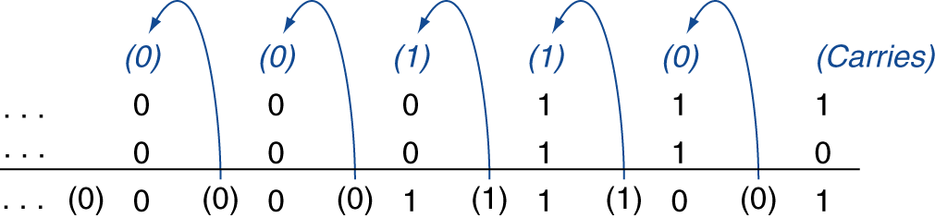
Integer Addition
Example: 7 + 6
§3.2 Addition and Subtraction
Overflow if result out of range
Adding +ve and –ve operands, no overflow
Adding two +ve operands
Overflow if result sign is 1
Adding two –ve operands
Overflow if result sign is 0

Slide 6
Integer Subtraction
Add negation of second operand
Example: 7 – 6 = 7 + (–6)
+7: 0000 0000 … 0000 0111 –6: 1111 1111 … 1111 1010 +1: 0000 0000 … 0000 0001
Overflow if result out of range
Subtracting two +ve or two –ve operands, no overflow
Subtracting +ve from –ve operand
Overflow if result sign is 0
Subtracting –ve from +ve operand
Overflow if result sign is 1

Slide 7
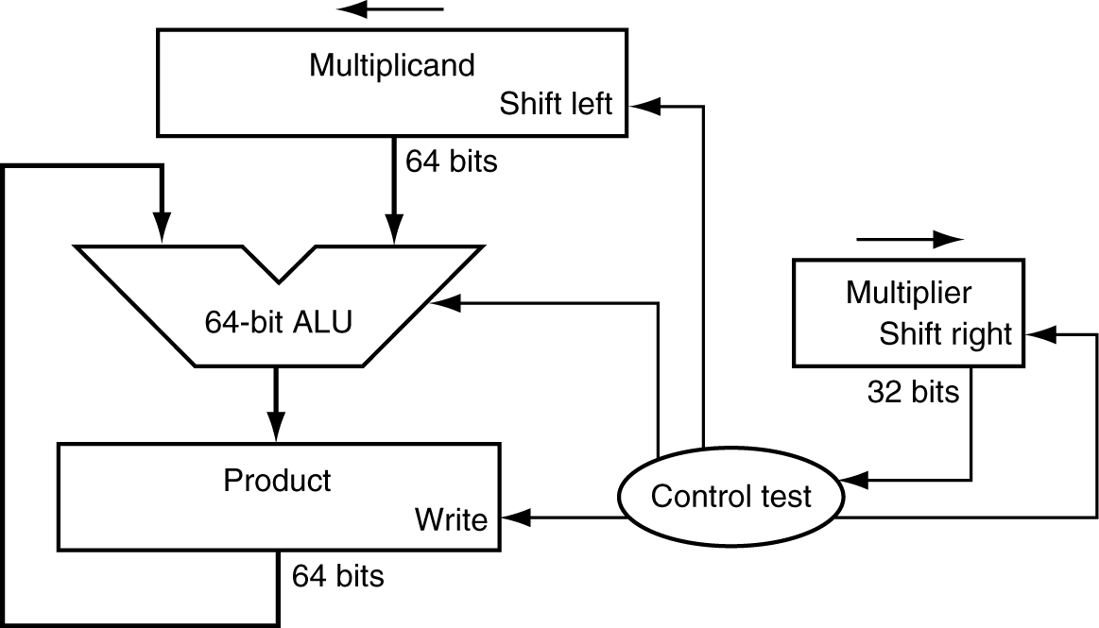
Multiplication
§3.3 Multiplication
Start with long-multiplication approach
multiplicand
1000
× 1001
1000
0000
0000
1000
1001000
multiplier
product
Length of product is the sum of operand lengths

Slide 8
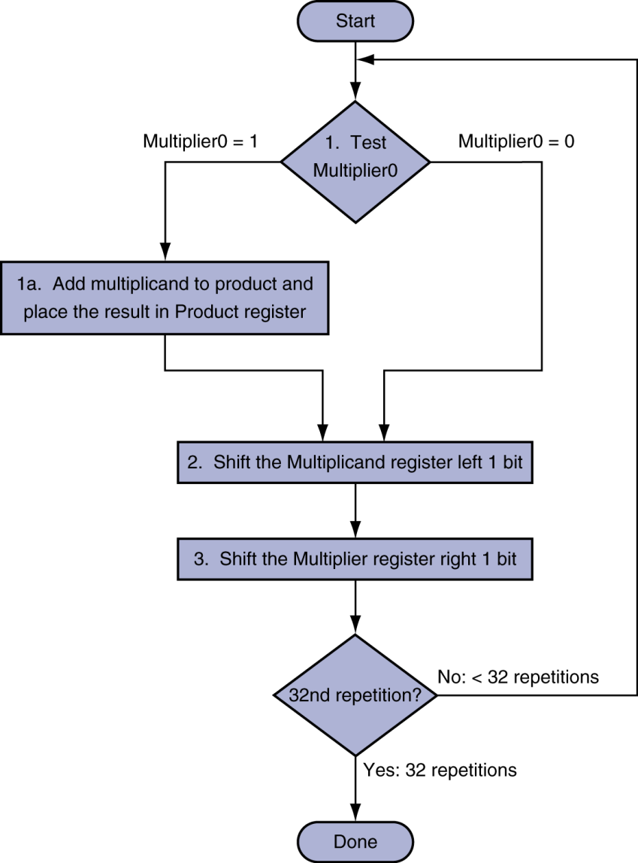
Multiplication Hardware
Initially 0

Slide 9
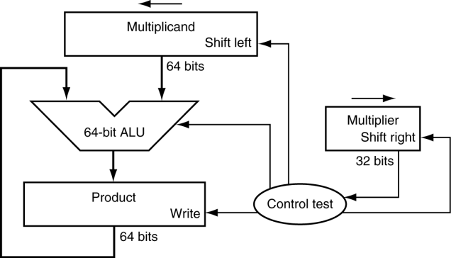
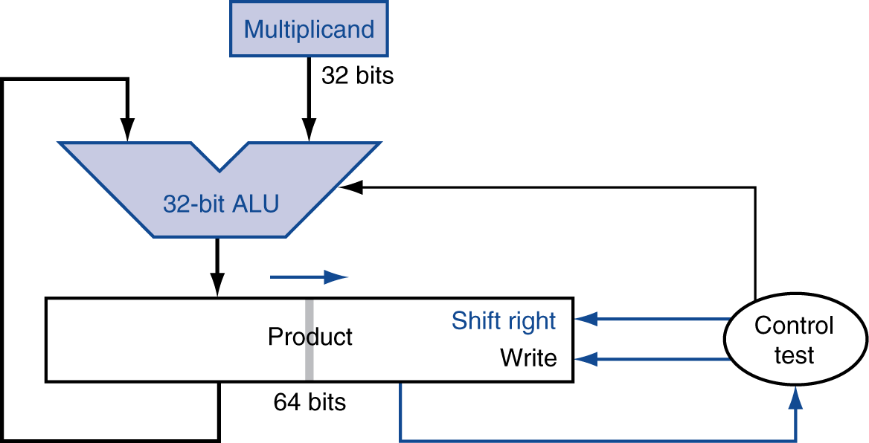
Optimized Multiplier
Perform steps in parallel: add/shift
One cycle per partial-product addition
That’s ok, if frequency of multiplications is low

Slide 10
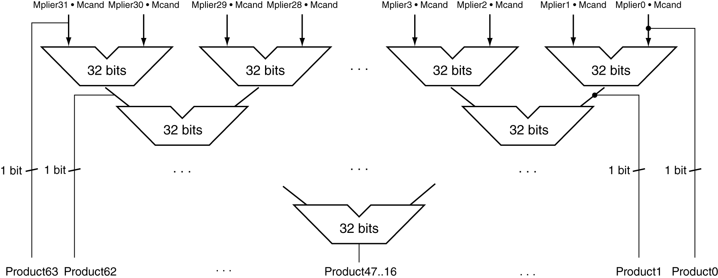
Faster Multiplier
Uses multiple adders
Cost/performance tradeoff
Can be pipelined
Several multiplication performed in parallel

Slide 11
Division
§3.4 Division
Check for 0 divisor
Long division approach
If divisor ≤ dividend bits
1 bit in quotient, subtract
Otherwise
0 bit in quotient, bring down next dividend bit
Restoring division
Do the subtract, and if remainder goes < 0, add divisor back
Signed division
Divide using absolute values
Adjust sign of quotient and remainder as required
quotient
dividend
1001
1000 1001010
-1000
10
101
1010
-1000
10
divisor
remainder
n-bit operands yield n-bit quotient and remainder

Slide 12
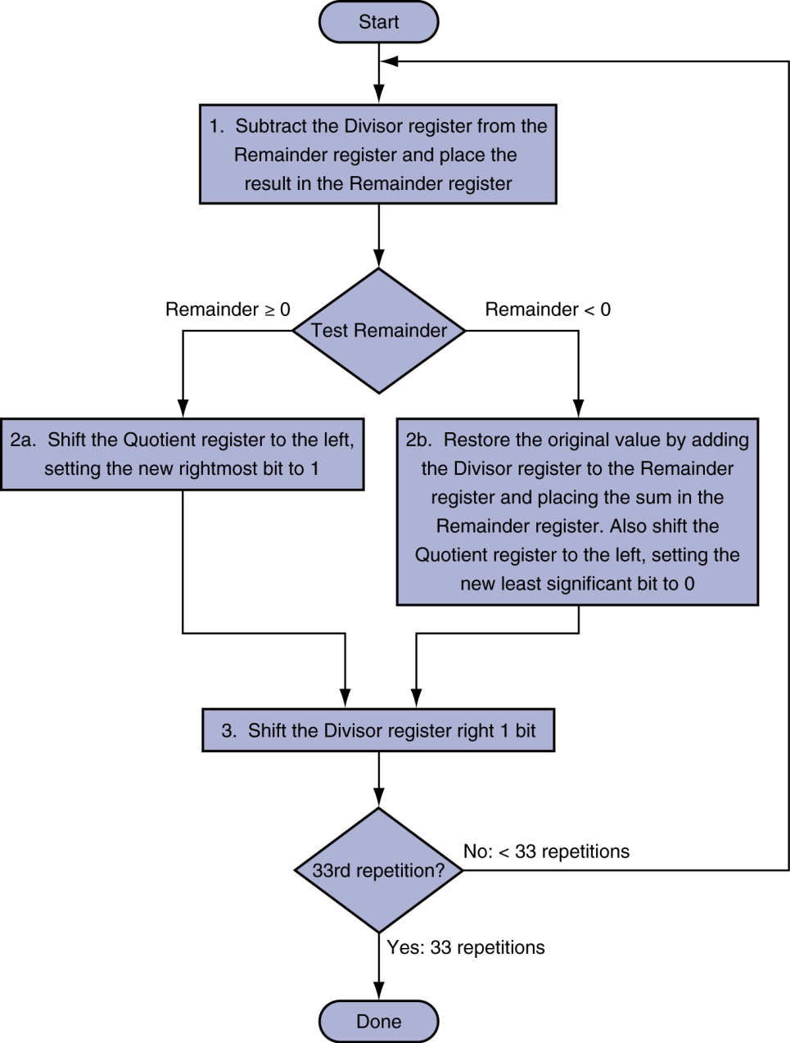
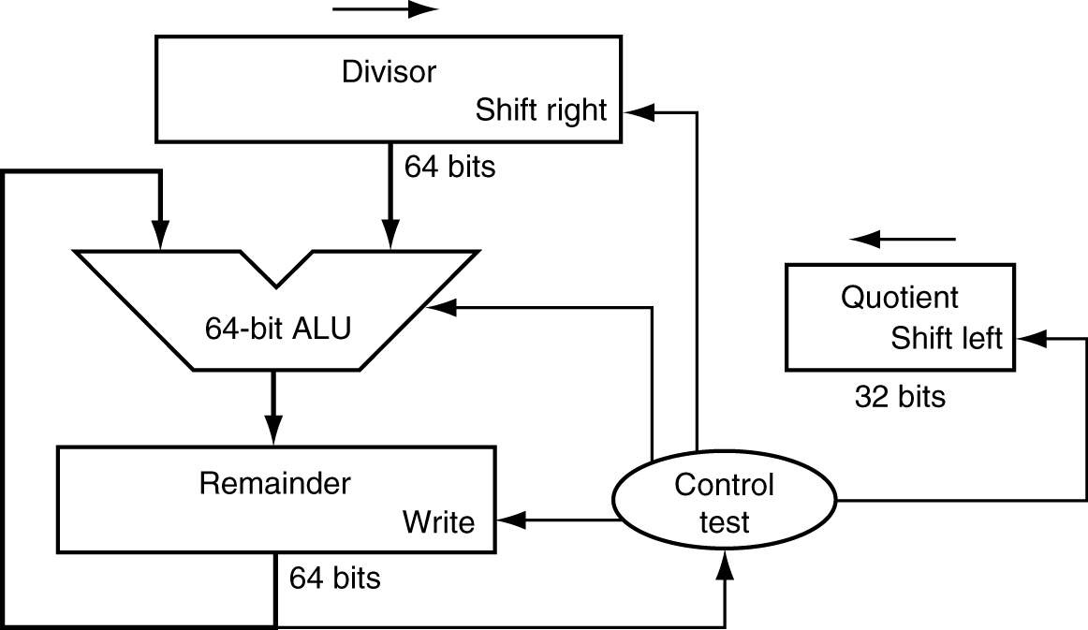
Division Hardware
Initially divisor in left half
Initially dividend

Slide 13
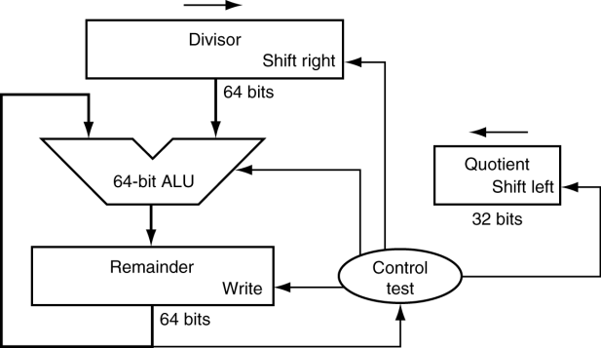
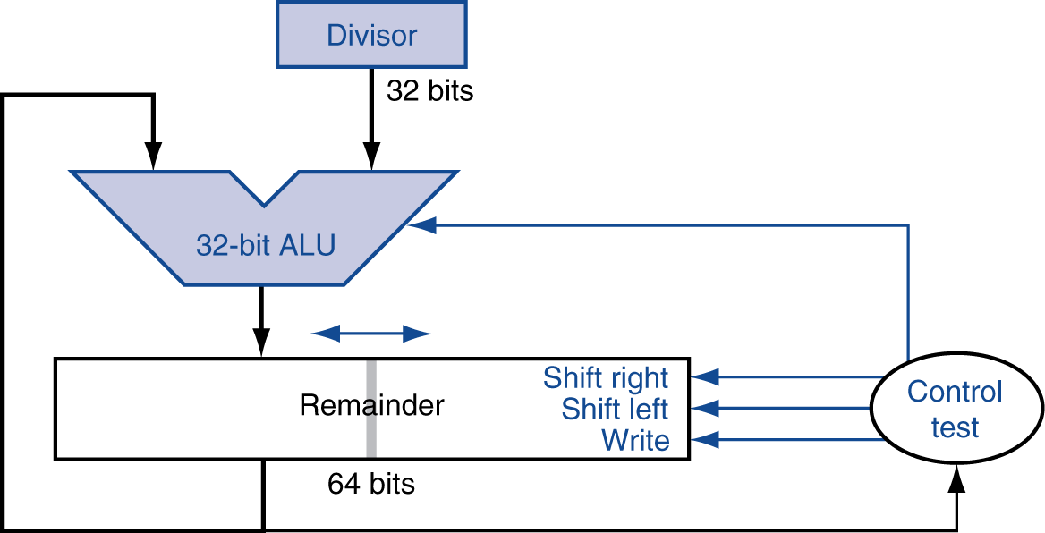
Optimized Divider
One cycle per partial-remainder subtraction
Looks a lot like a multiplier!
Same hardware can be used for both

